Slide 1

Fundamentals of Data Science
International Master of Data Science
Fall and Winter Terms | 2024-25

Slide 2
Fundamentals of Data Science
CH.01 Introduction
Theory and course introduction
Practical: using Jupyter Notebook online and offline

Slide 3

Approaches to Practical
Jupyter Notebook
Online
Offline

Slide 4

ONLINE APPROACH

Slide 5

Google Colab, short for Google Colaboratory
cloud-based platform provided by Google
write and execute Python code in a Jupyter Notebook environment
no installation or setup required on your local machine.
access to powerful GPUs (Graphics Processing Units) and TPUs (Tensor Processing Units) for accelerated computing

Slide 6

Using Jupyter notebook online
Requirements:
- Gmail address
- Google drive
- internet connection
Link to introduction to Google Colab: https://www.youtube.com/watch?v=inN8seMm7UI

Slide 7
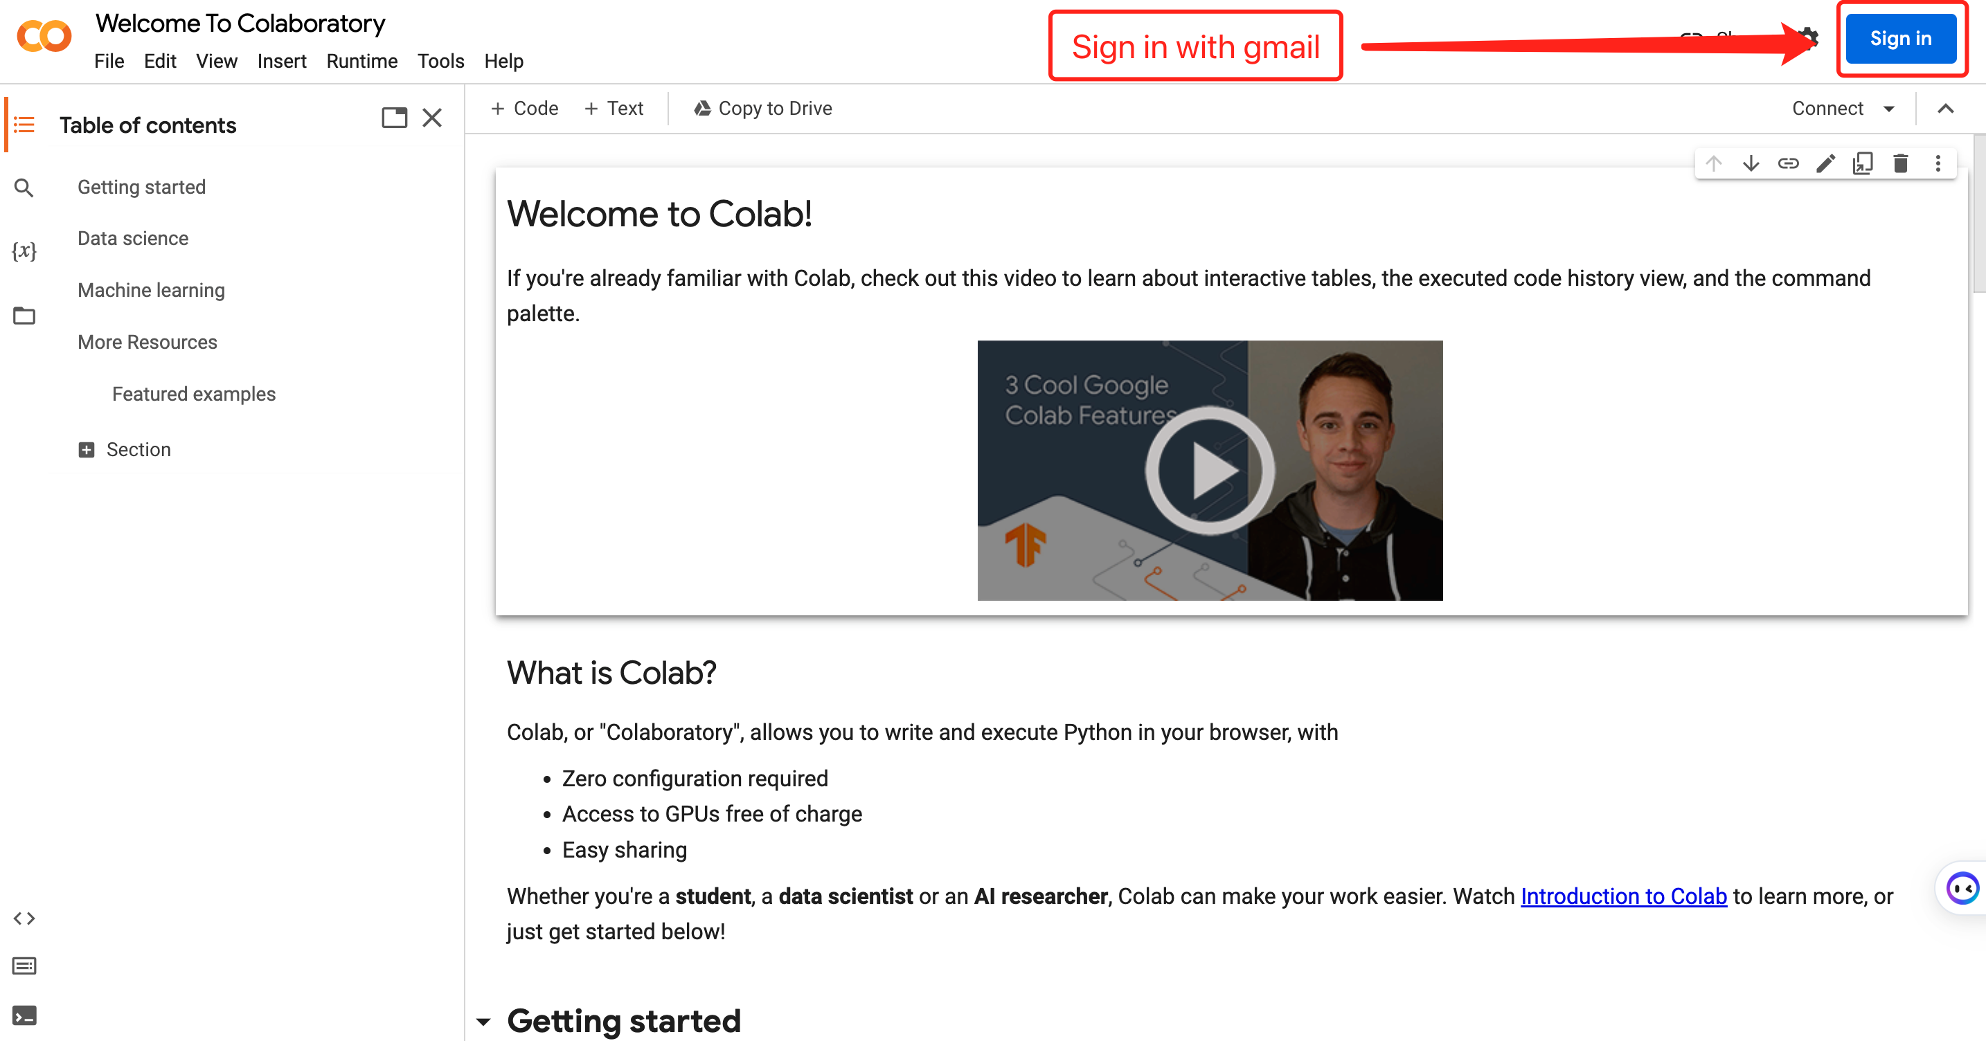
Sign in to Google Colab

Slide 8
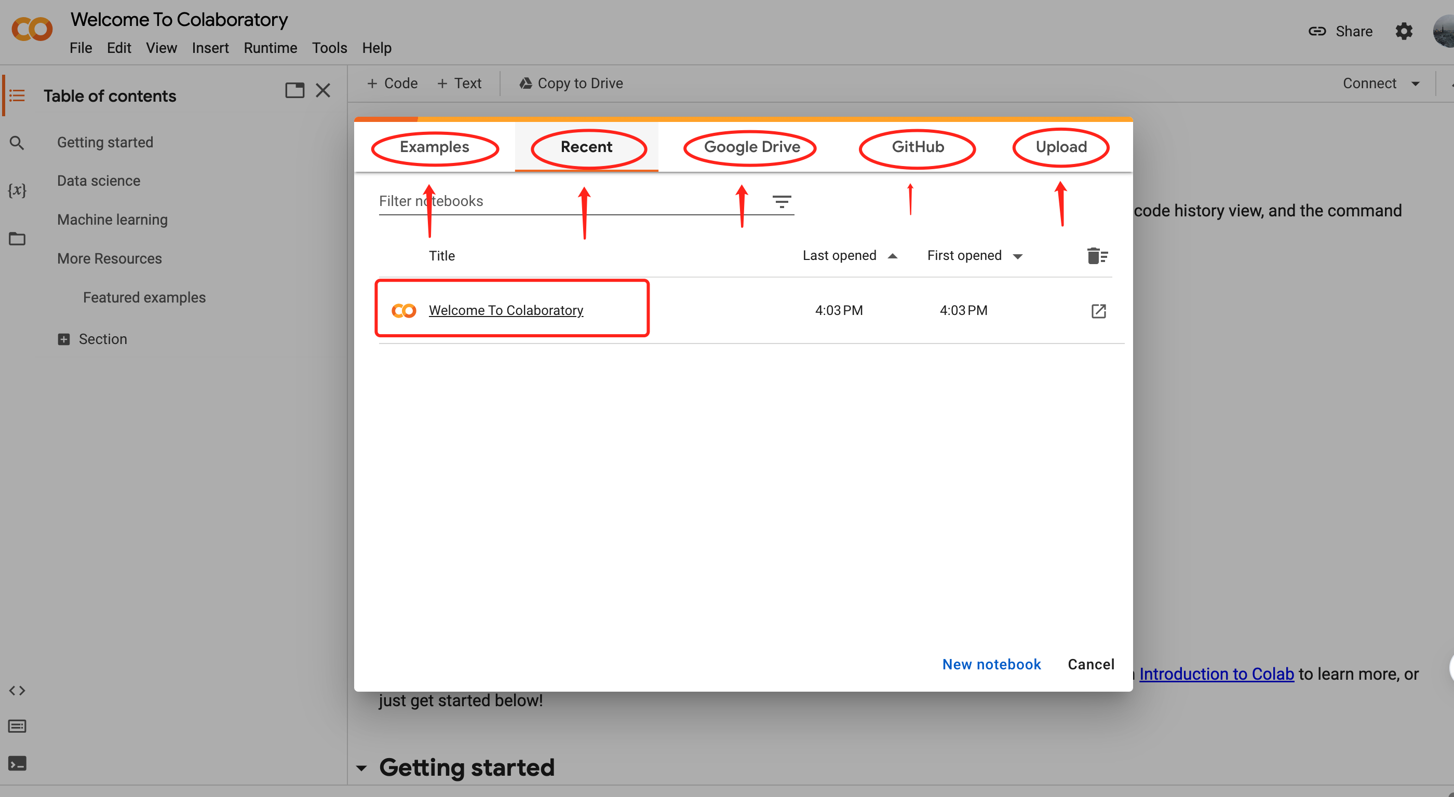
Access Repositories

Slide 9
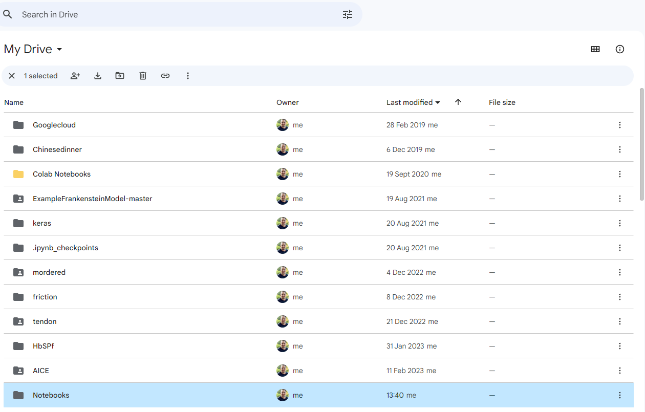

Import Files
Import data from;
Google Drive
Spreadsheets
GitHub
Find more here;
-> Link
Steps:
Add the folder ‘Notebooks’ from your course folder into your google drive
Notebooks

Slide 10
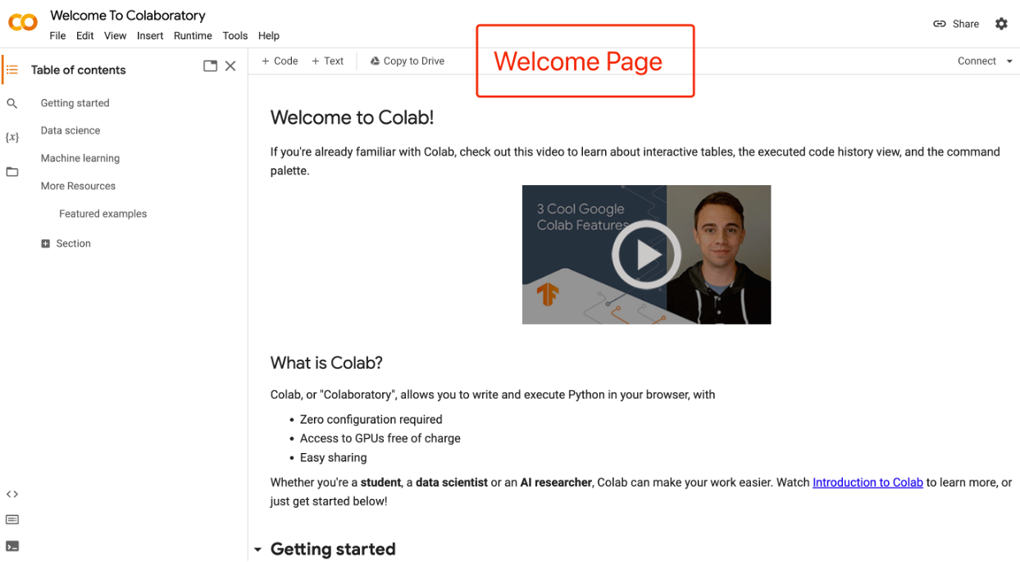
Work Environment

Slide 11
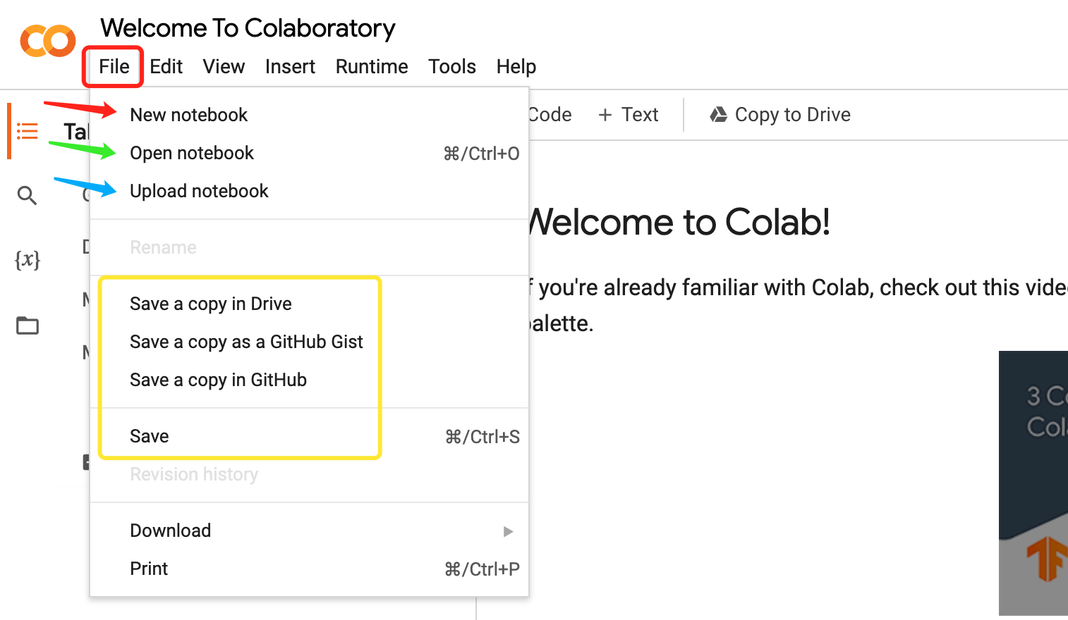
Getting Started

Slide 12
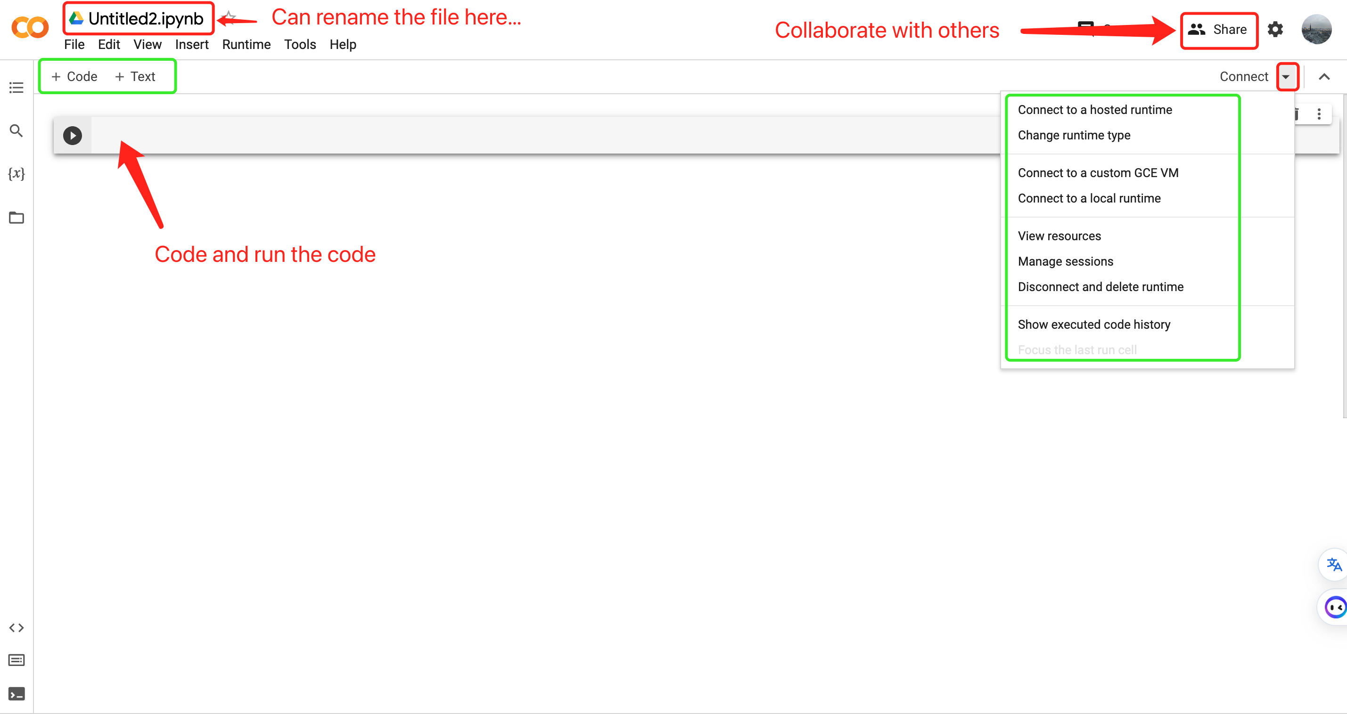
Basics

Slide 13
Mounting Google Drive
Mounting Google Drive on Google Colab
Follow the procedure in the notebook including the installation of google.colab function drivedrive.mount:
from google.colab import drivedrive.mount('/content/drive')

Slide 14

OFFLINE APPROACH

Slide 15
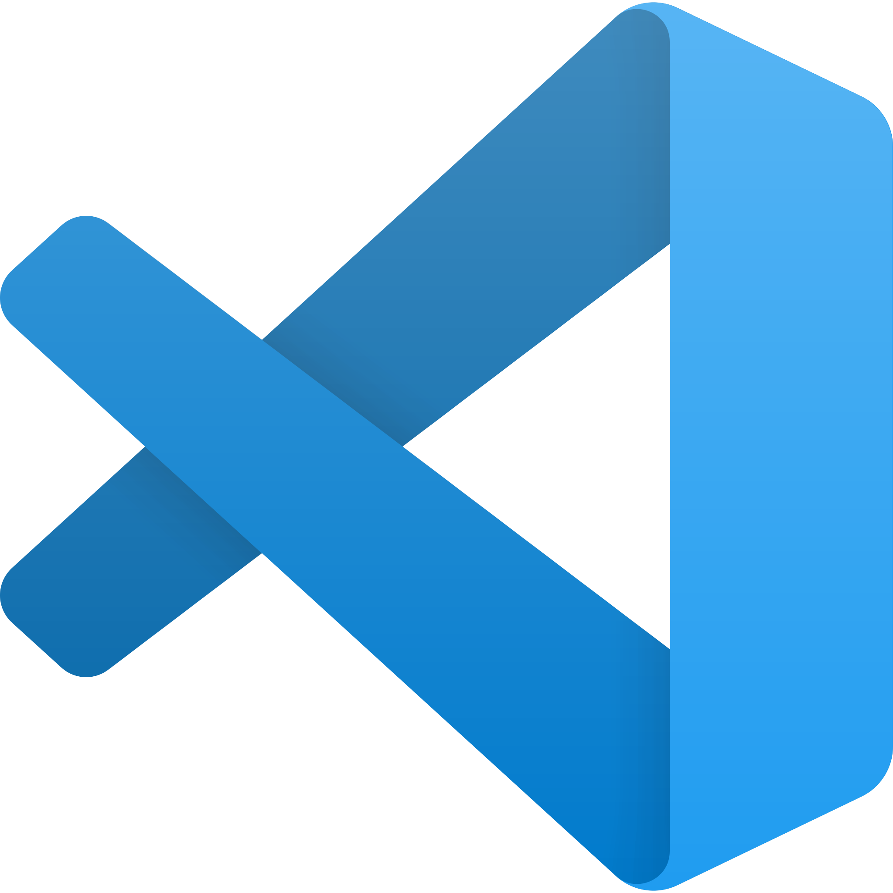
Visual Studio Code
Versatility: Visual Studio Code is a versatile code editor that caters to the needs of a wide range of developers, from beginners to seasoned professionals, across different programming languages and platforms.
Cross-Platform: VS Code is available for Windows, macOS, and Linux, making it highly accessible for developers on different operating systems.
Intelligent Code Editing: It offers features like syntax highlighting, autocompletion, code navigation, and real-time error checking to enhance productivity.
Language Support: It provides support for a wide range of programming languages through extensions, including Python, JavaScript, C++, and more.
Live Share: VS Code offers a Live Share feature that allows developers to collaborate in real time on code projects, making it ideal for pair programming and remote collaboration.

Slide 16


Slide 17
The Three Musketeers
Homebrew (Recommended)
Manually
Manually
3. VS Code
1. Homebrew
2. Python
Homebrew (Recommended)
Manually (Recommended)
Terminal

Slide 18

1. Homebrew
Uses Terminal to function
A user-friendly computer assistant
Installs and updates software
No need for advanced computer skills
Ensures software compatibility and functionality
Keeps your computer organized and up-to-date

Slide 19
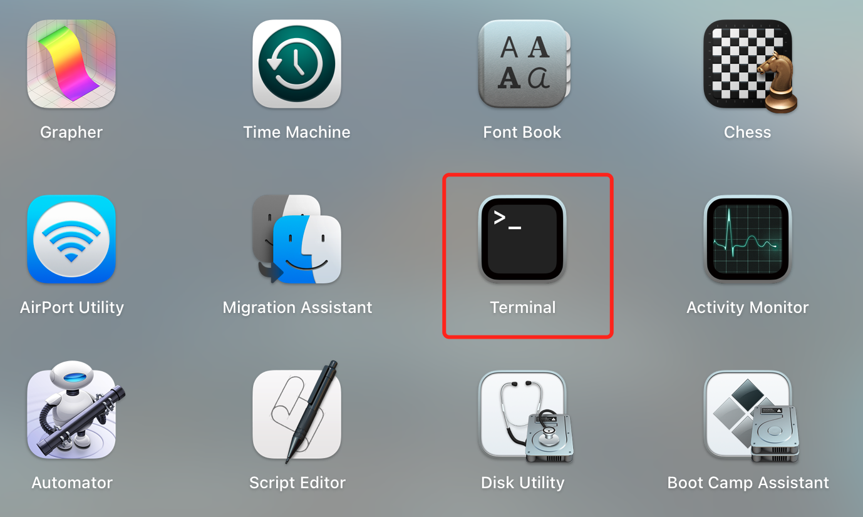
Homebrew Installation from the terminal (Not Recommended)
Copy and paste the following code in the Terminal;
/bin/bash -c "$(curl -fsSL https://raw.githubusercontent.com/Homebrew/install/HEAD/install.sh)"

Slide 20
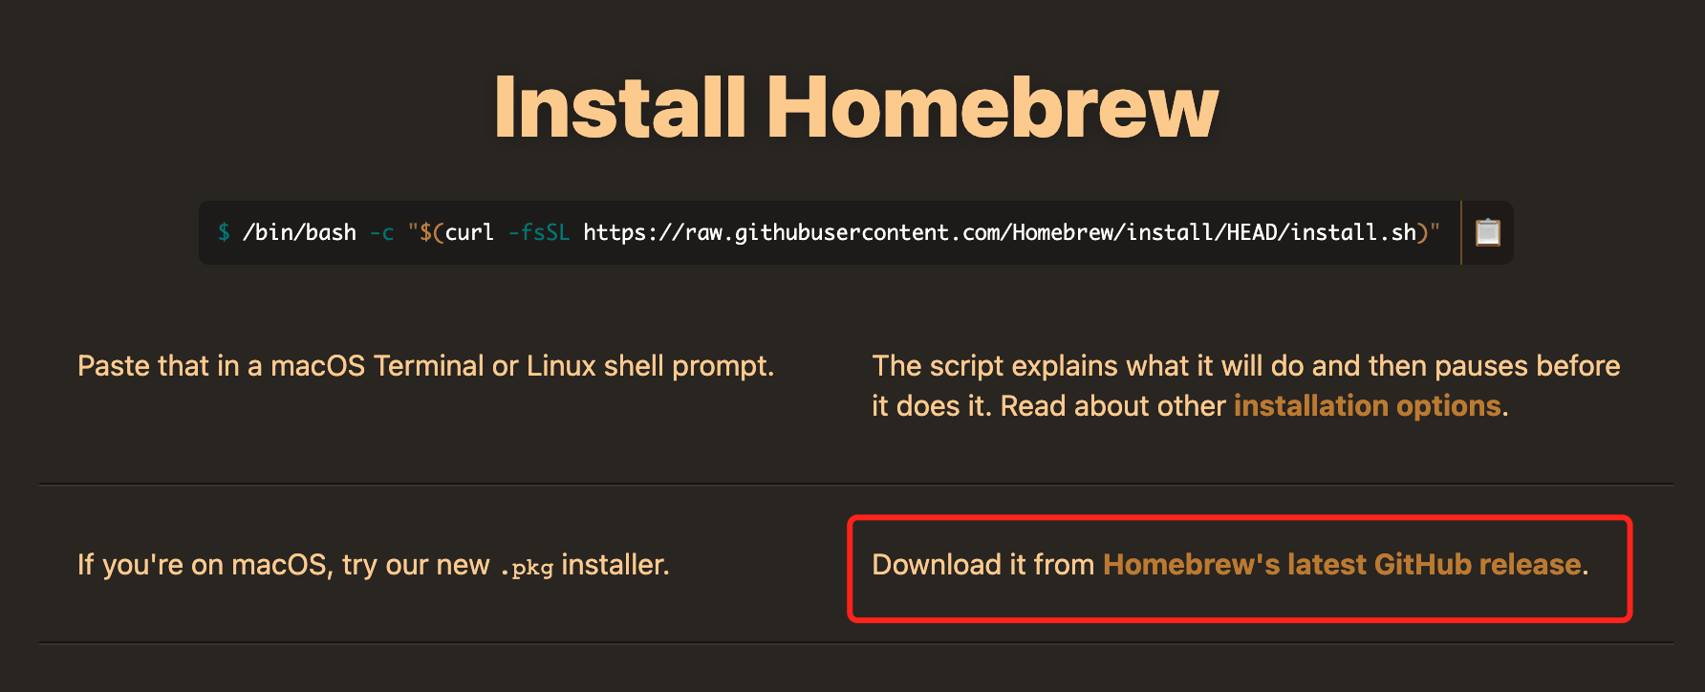
Manual Guide (Recommended)

Slide 21
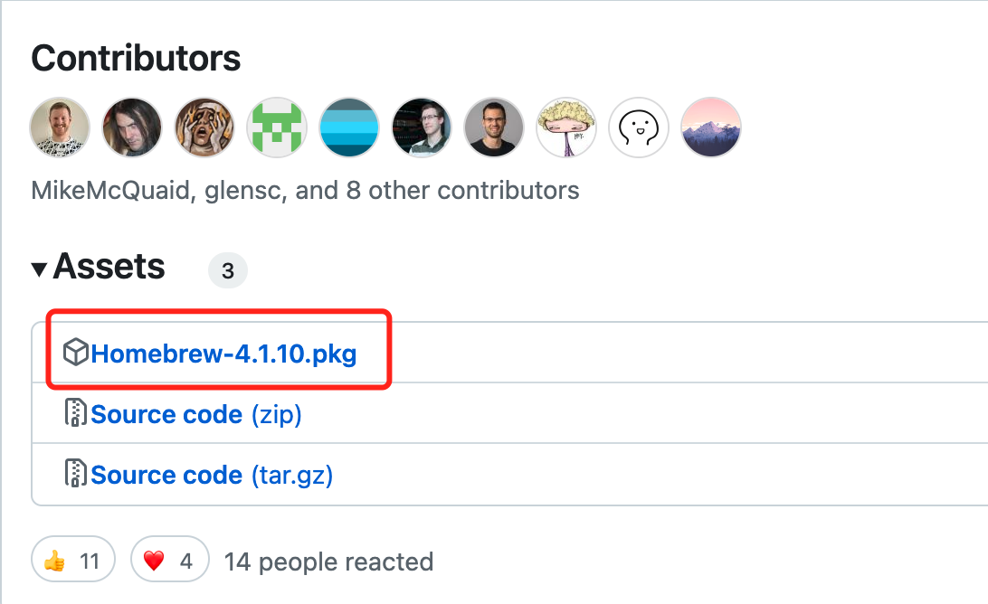
Download the .pkg file

Slide 22
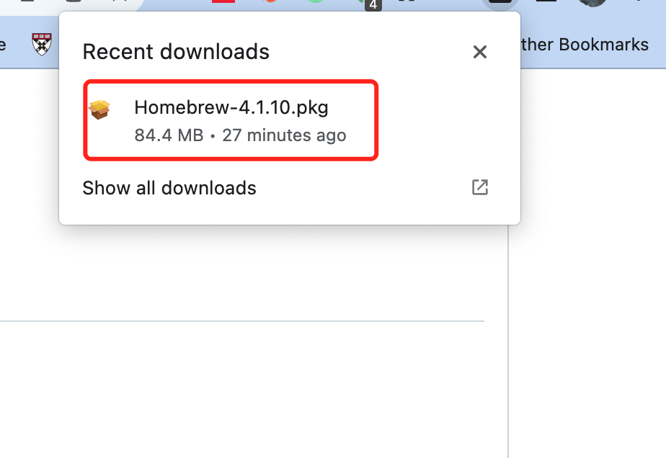
Go to Downloaded Directory
Start Manual Installation

Slide 23
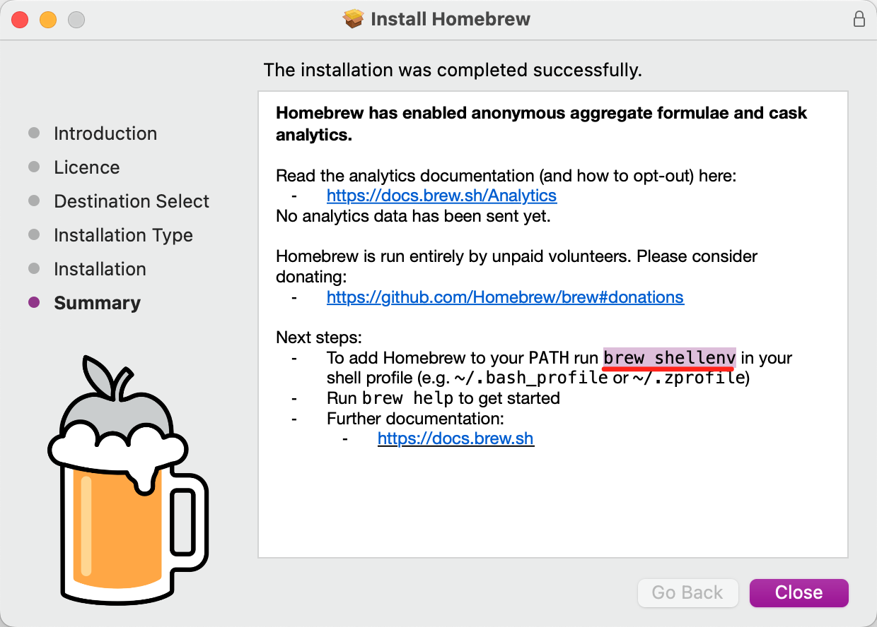
Important Note
Copy and paste the following code in the Terminal;
brew shellenv

Slide 24
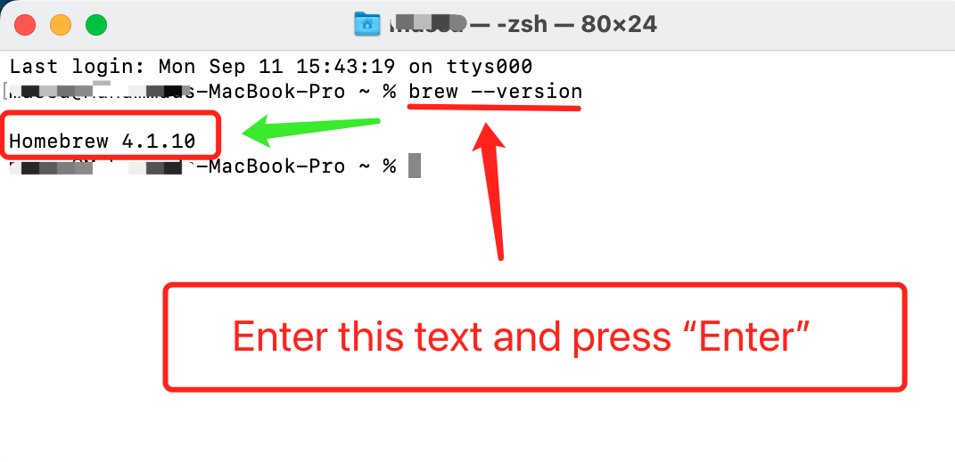
Confirm Installation
Copy and paste the following code in the terminal;
brew --version

Slide 25

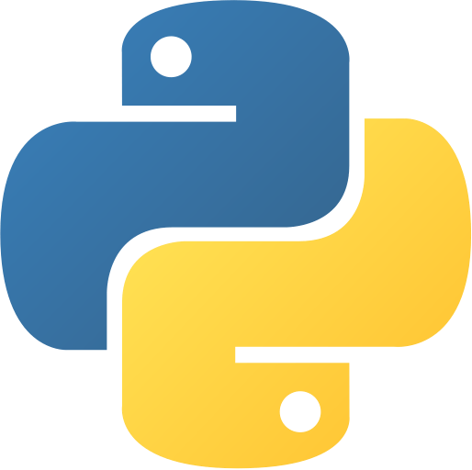
2. Python
Interpreted Language: Python is an interpreted language, which means you can run code without compiling it.
High-Level Language: Python provides abstractions that allow developers to focus on the logic of their programs rather than low-level details.
Cross-Platform: Python is available on multiple platforms, including Windows, macOS, and Linux, making it highly portable.
Community and Ecosystem: Python has a large and active community of developers, contributing to its rich ecosystem of libraries and frameworks.
Data Science and Machine Learning: Python is popular in data science and machine learning with libraries like NumPy, pandas, scikit-learn, and TensorFlow.

Slide 26
Homebrew the Python (Recommended)
Copy and paste the following code in the terminal;
brew install python@3.11

Slide 27
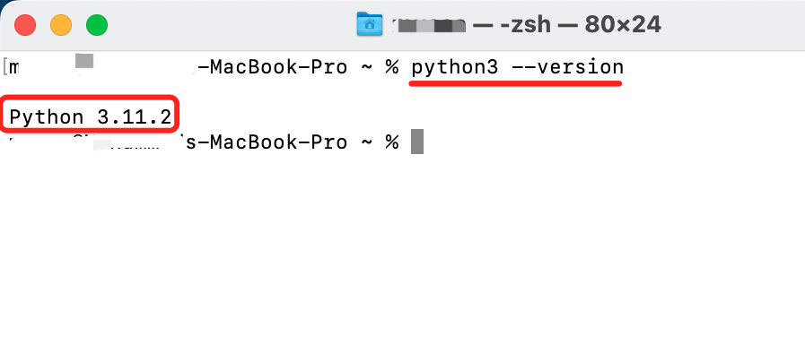
Confirm Installation
Copy and paste the following code in the terminal;
python3 --version

Slide 28
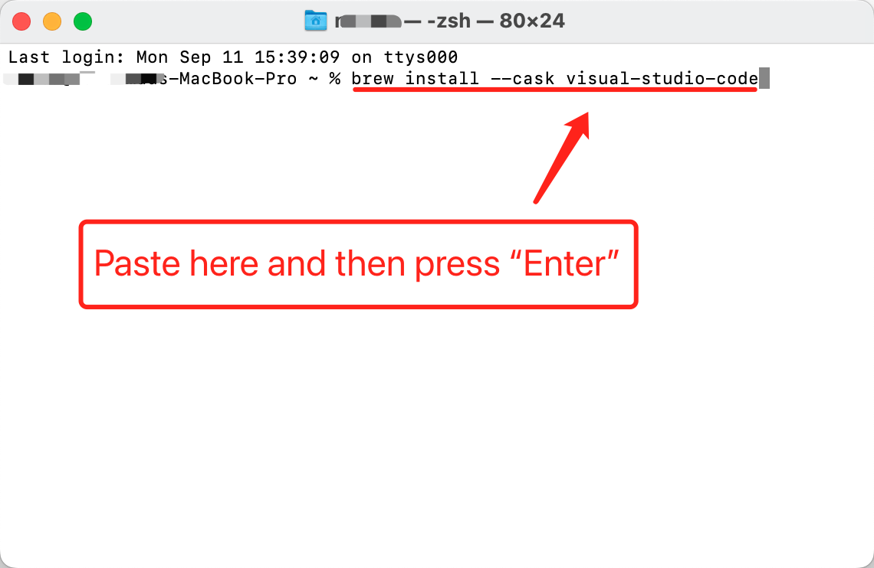
Homebrew the VS code (Recommended)
Copy and paste the following code in the Terminal;
brew install --cask visual-studio-code

Slide 29
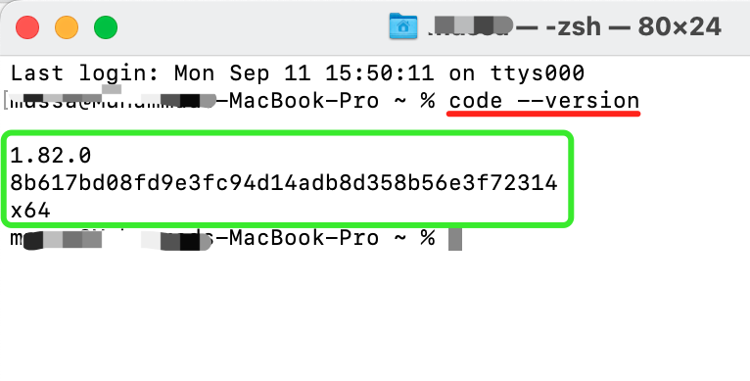
Confirm Installation
Copy and paste the following code in the Terminal;
code --version

Slide 30
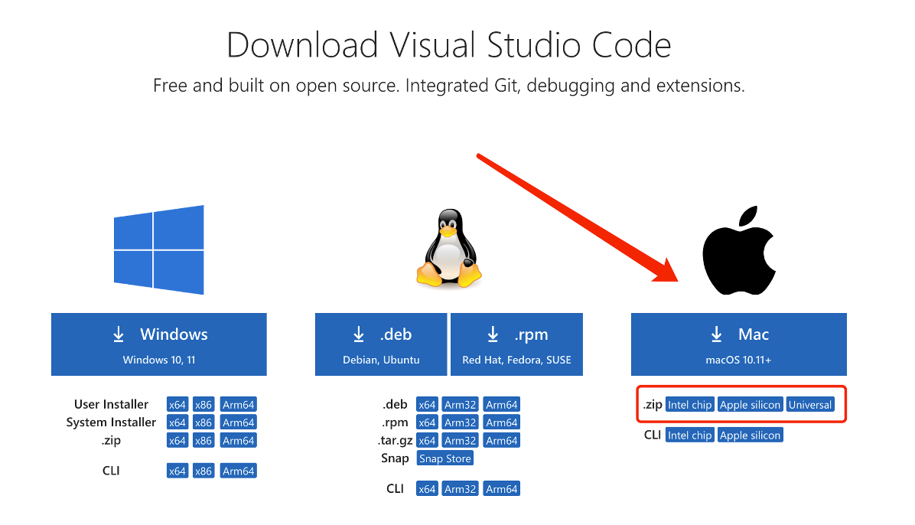
VS Code Manual Installation (Not Recommended)
Download Visual Studio Code - Mac, Linux, Windows
https://code.visualstudio.com/Download

Slide 31
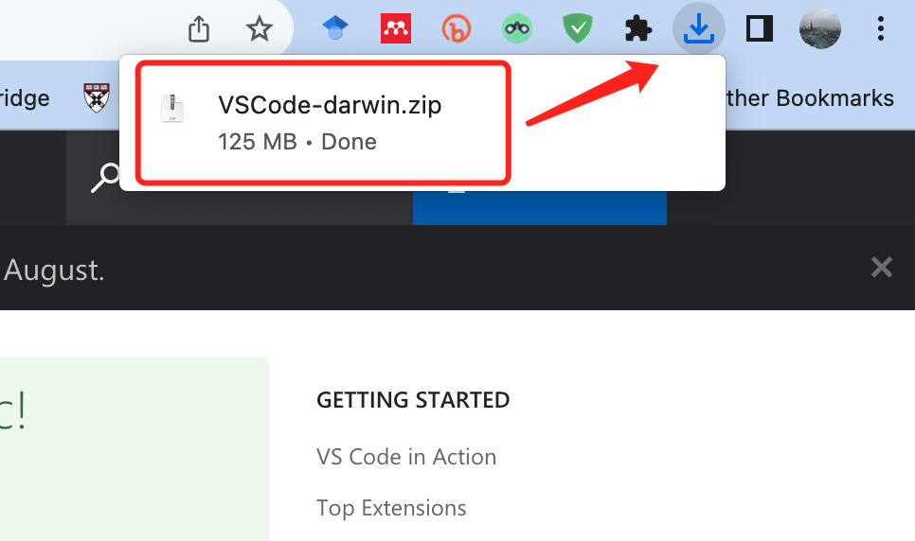
Find the Downloaded File

Slide 32
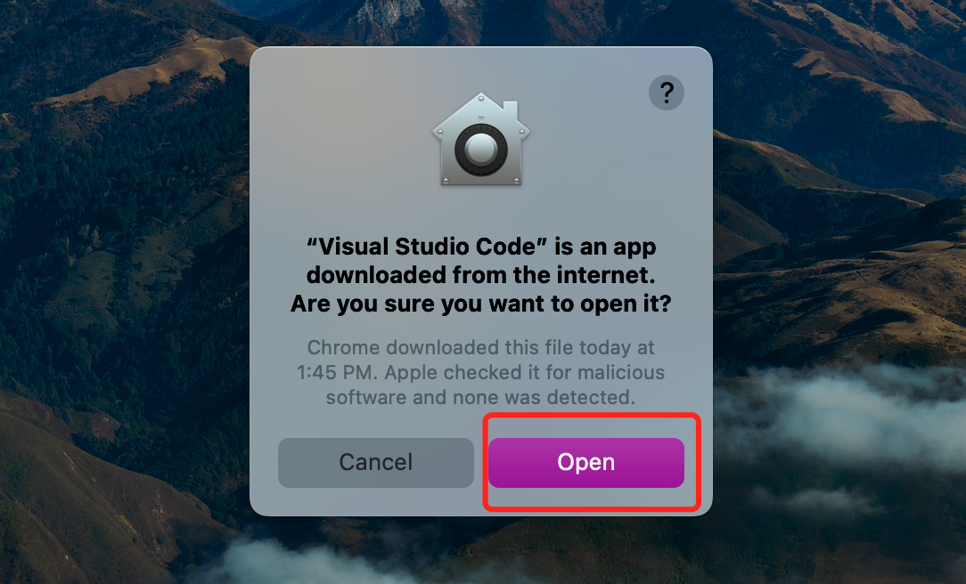
Ready to Use

Slide 33
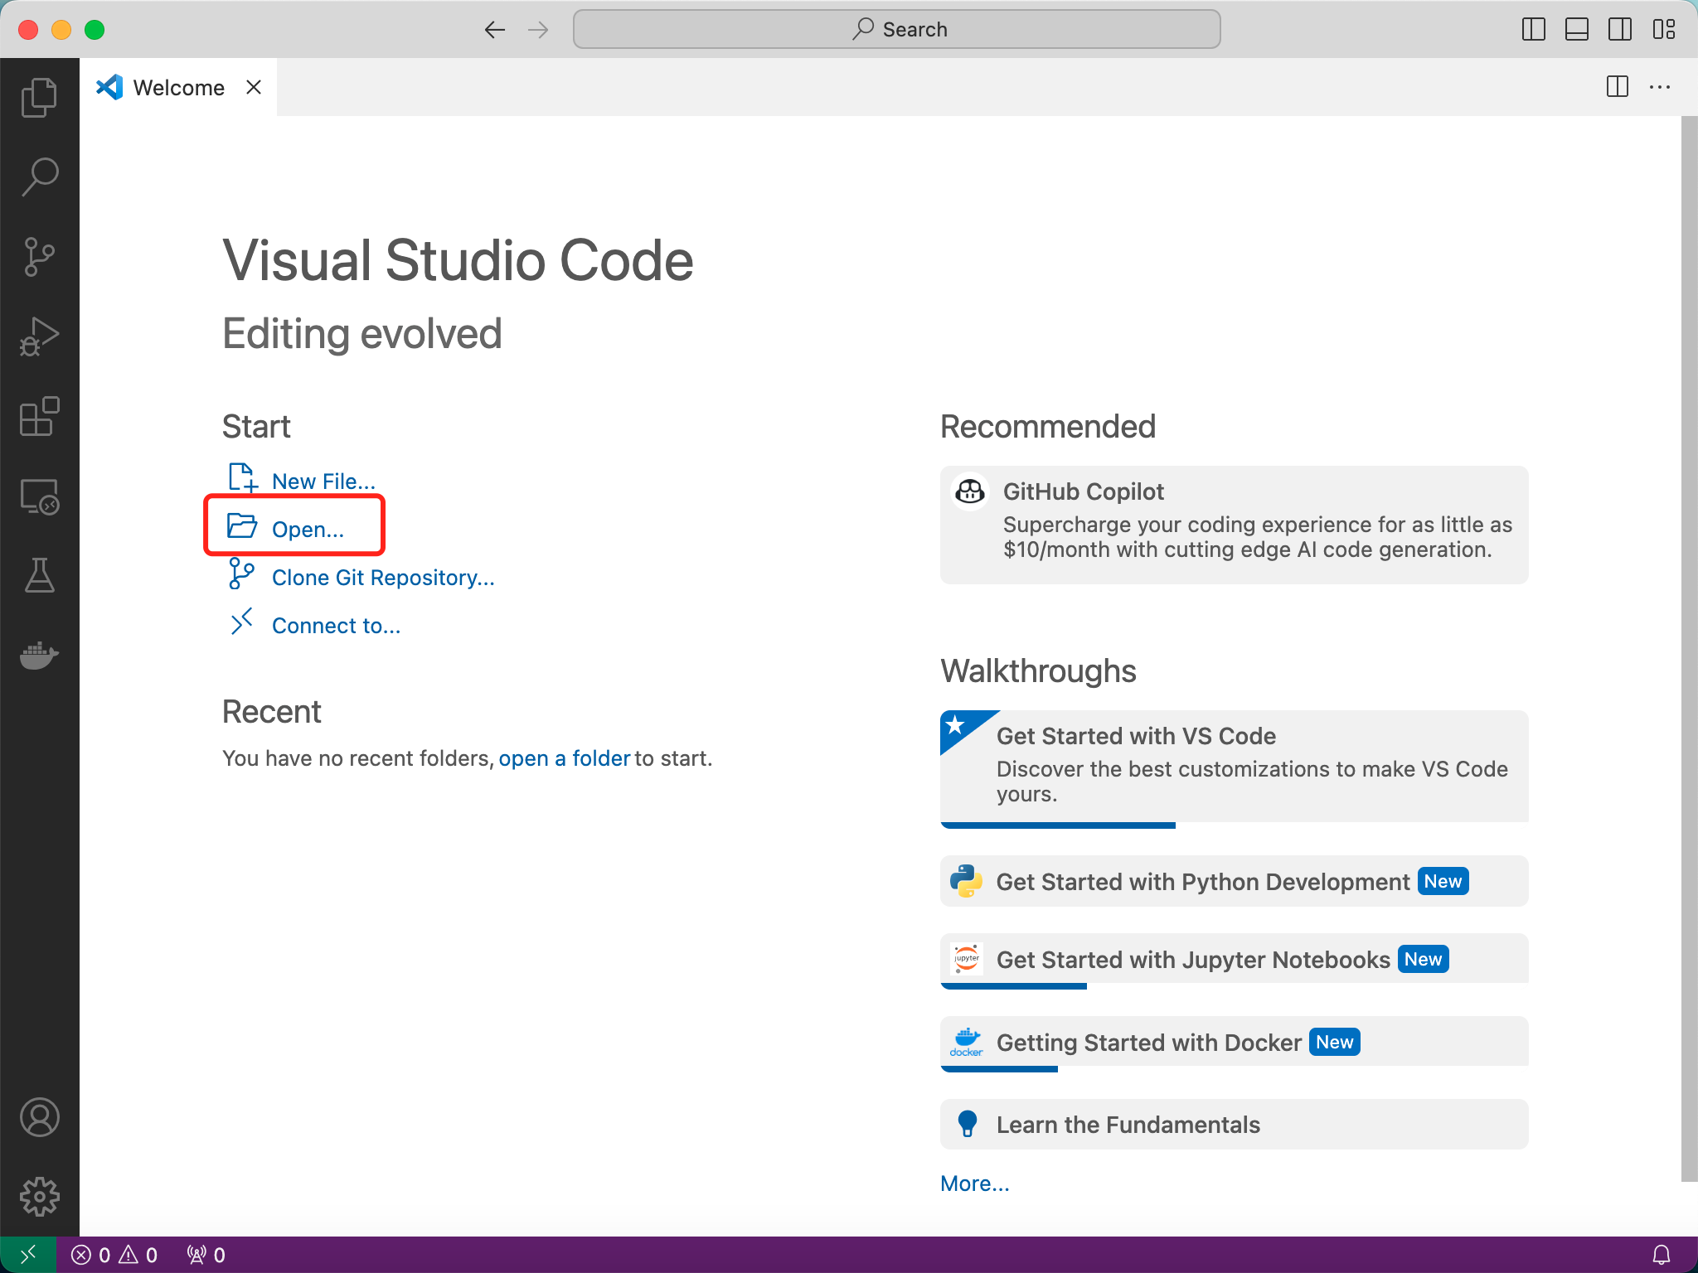
Getting Started

Slide 34
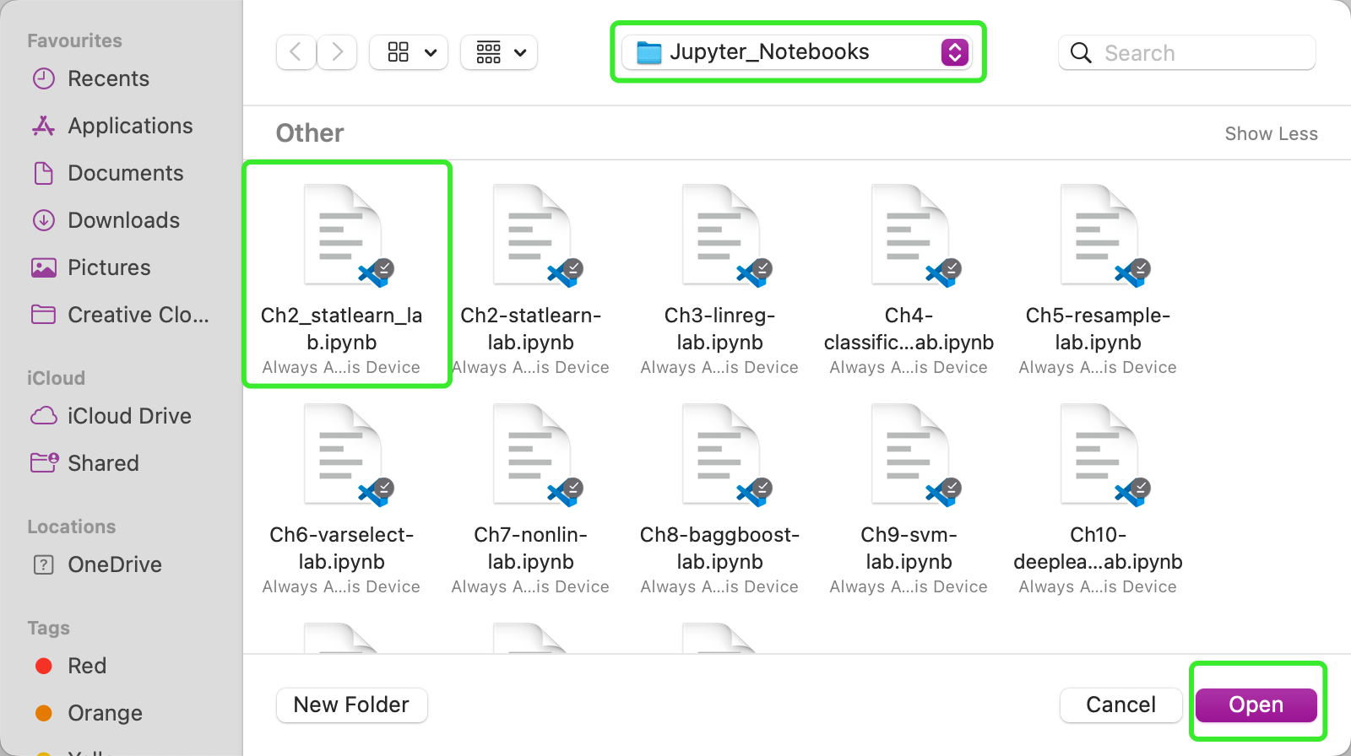
Open the Chapters

Slide 35
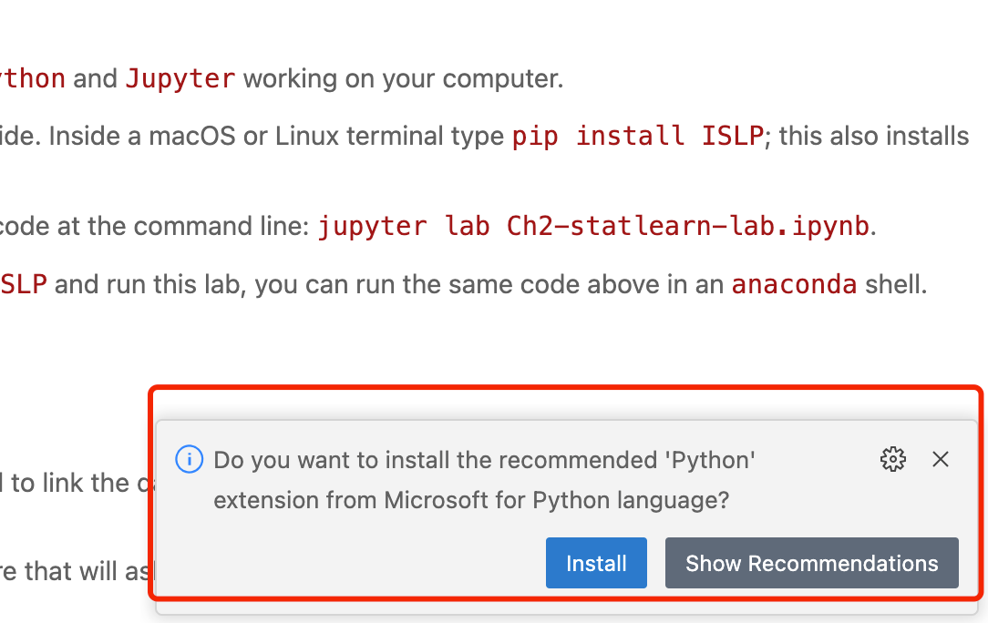
Python Extension
Note: As you start to use VS Code, these messages for extension installtion will appear automatically time to time to support the working environment.

Slide 36
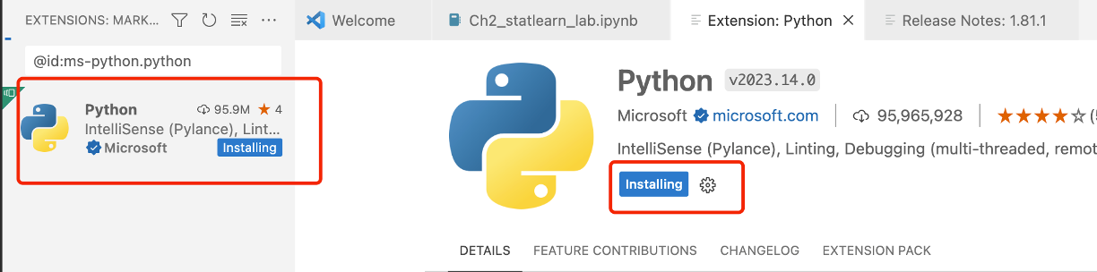
Installation Process

Slide 37
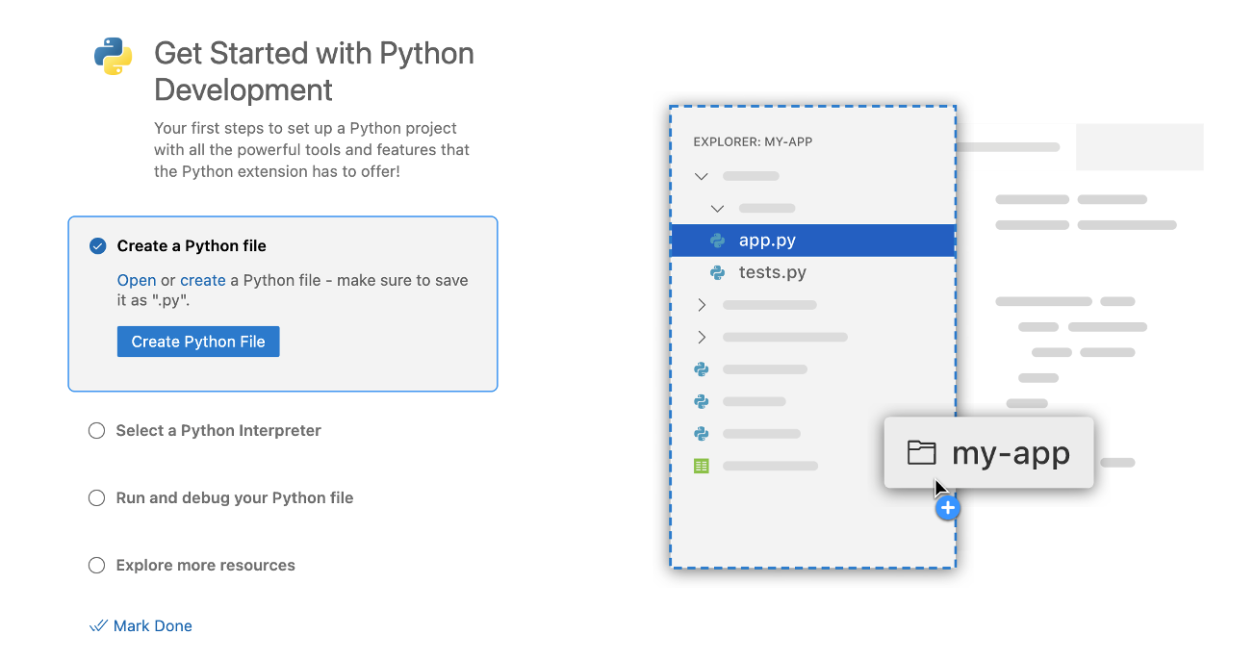
Tick all the options

Slide 38
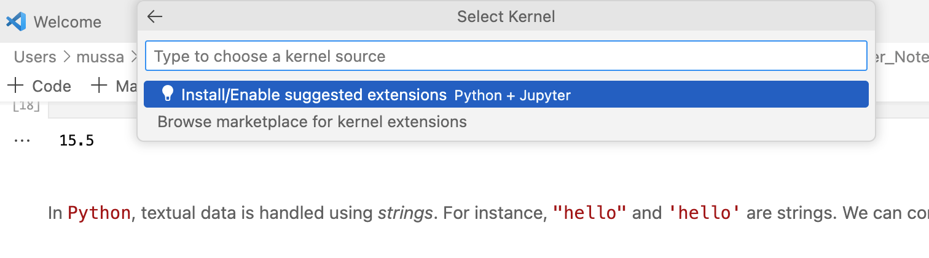
Install Python + Jupyter Extension

Slide 39
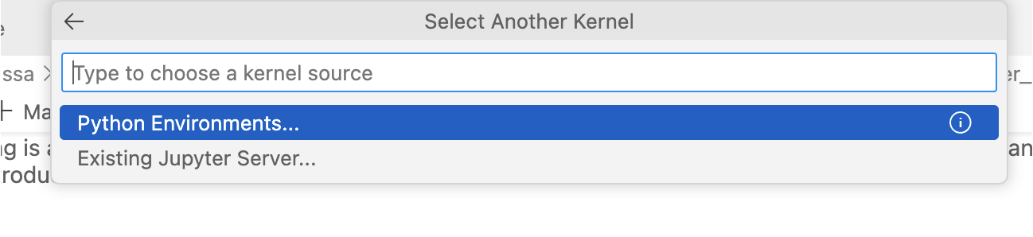
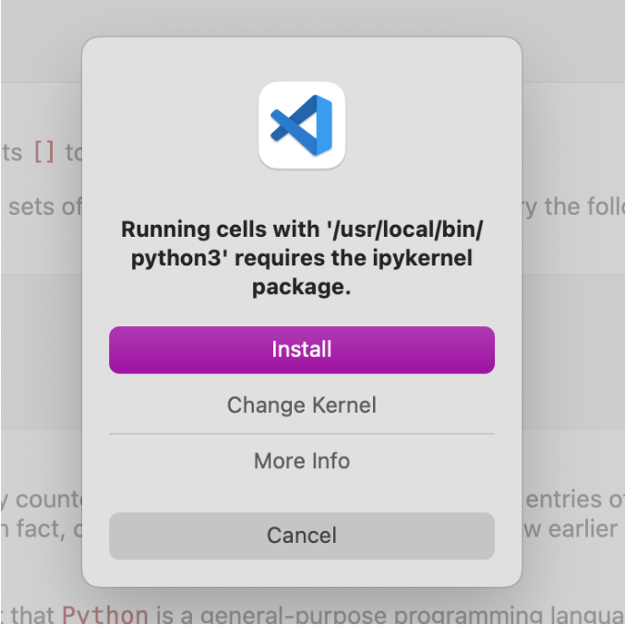
Install Python Environment

Slide 40
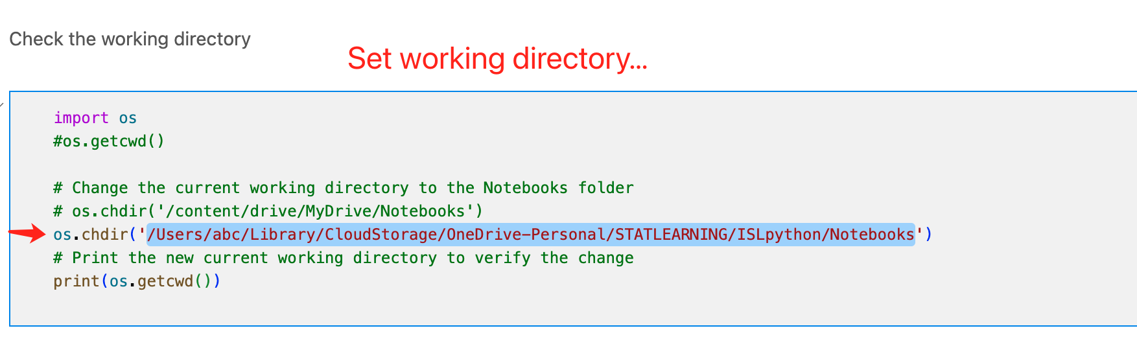
Set Working Directory

Slide 41
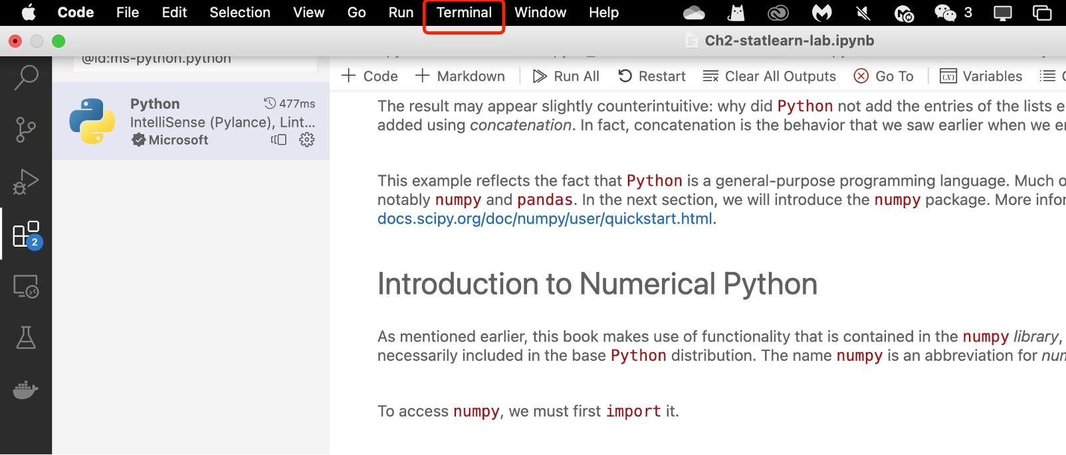
Installing Packages

Slide 42
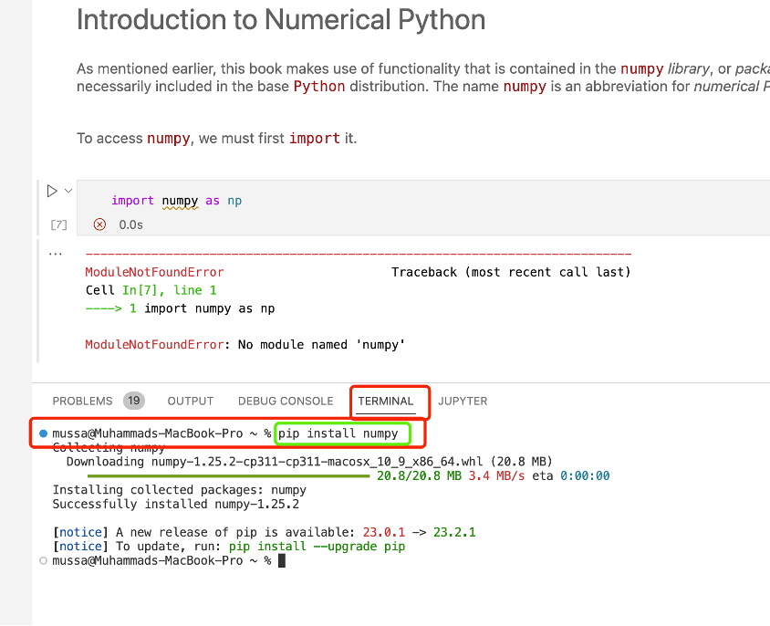
Use VS Code Terminal for Installation
pip install numpy

Slide 43
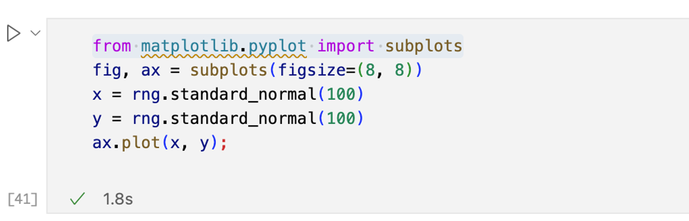
Note: If you see a similar code, it means you need to install a package and use the VS terminal to install
Pip install matplotlib

Slide 44
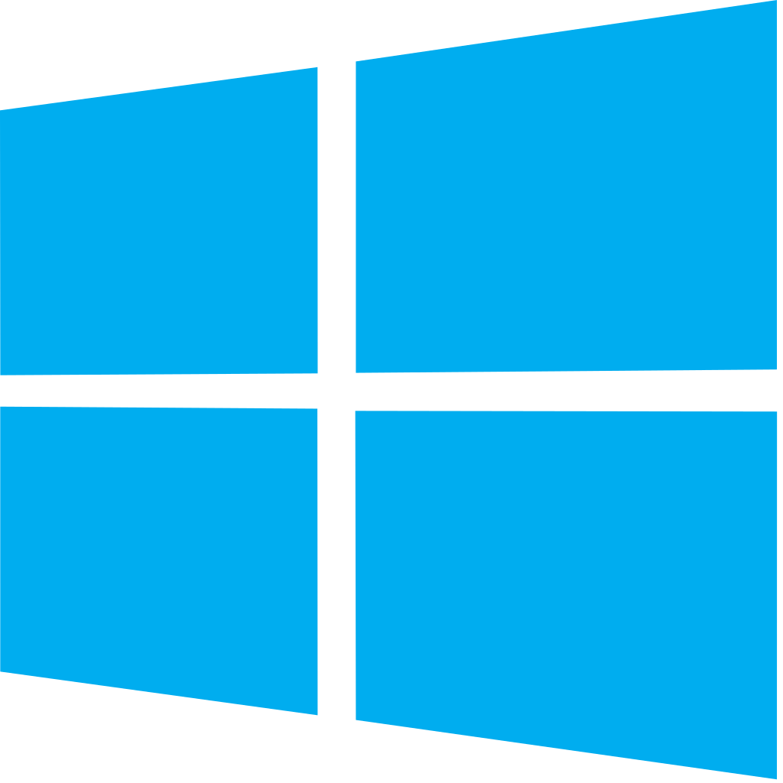
For Windows Users

Slide 45
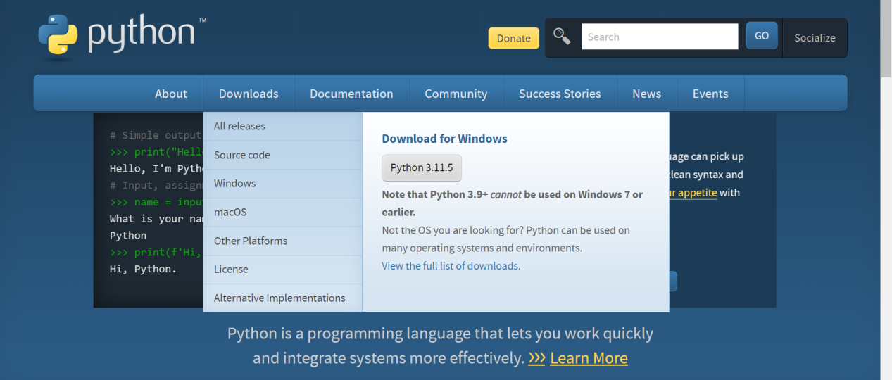
Installation
If Python is not installed on your machine (min 3.8) then:
Go to https://www.python.org/ and install the latest version for your machine

Slide 46
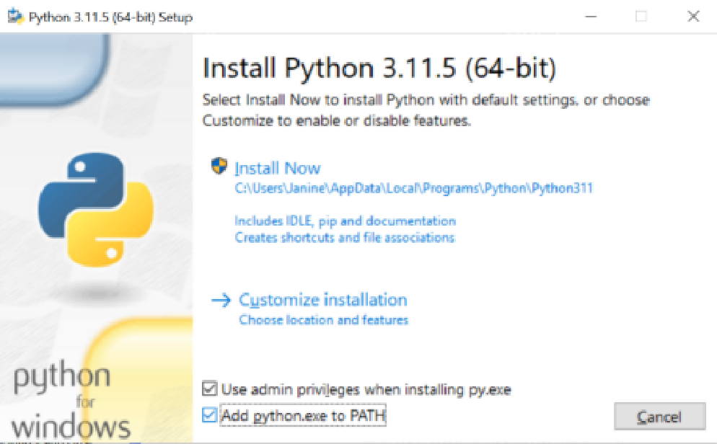
Note: Once the file is downloaded, click twice on it to run the .exe file
Then make sure that the “Add python.exe to PATH’’ is activated.

Slide 47
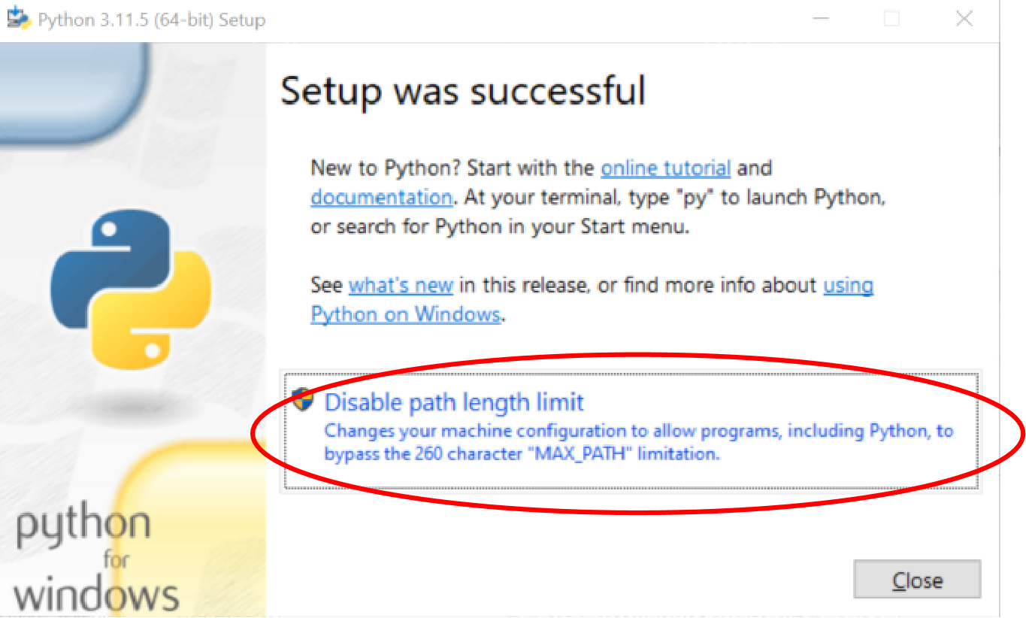
Click on this message;

Slide 48
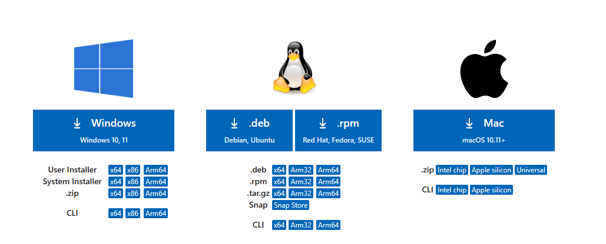
Download VS Code
Visual Studio Code Manual Installation
Download Visual Studio Code - Mac, Linux, Windows
https://code.visualstudio.com/Download
most machines
are x64

Slide 49
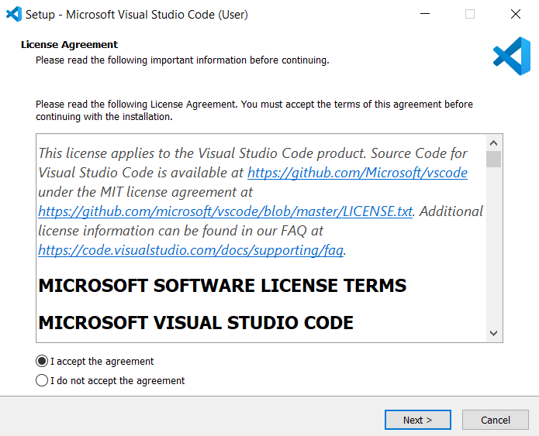
VS Code Installation
Now restart your computer
--> And let’s install VS Code:

Slide 50
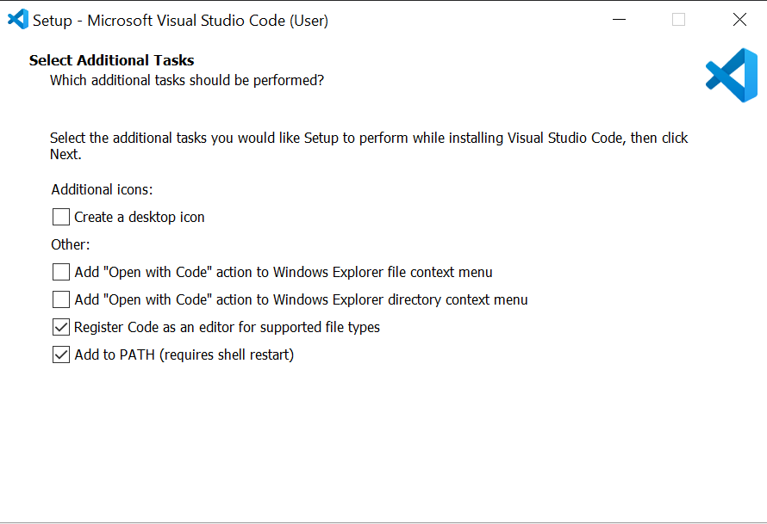
Install Visual Studio Code
Make sure that you:
install the User version
activate ‘Add to PATH (requires shell restart)’
After you complete the installation, RESTART YOUR COMPUTER

Slide 51
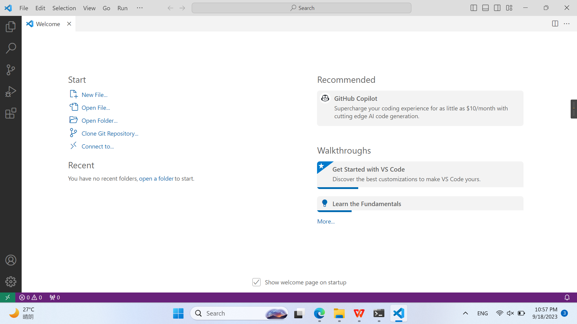
Open a .ipynb
Once VSCode runs open a .ipynb file from your course folder (Notebooks)

Slide 52
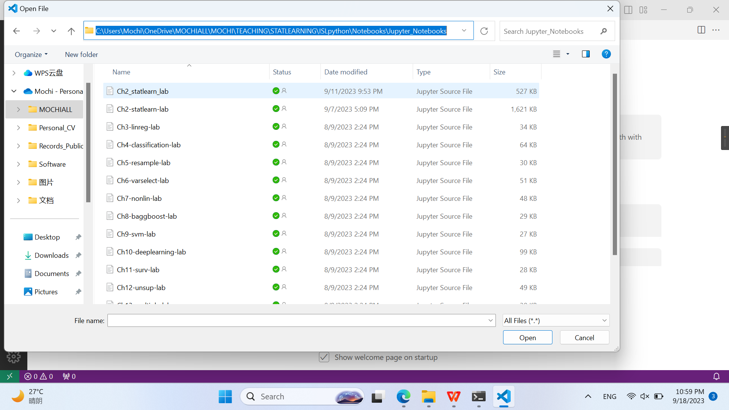

Slide 53
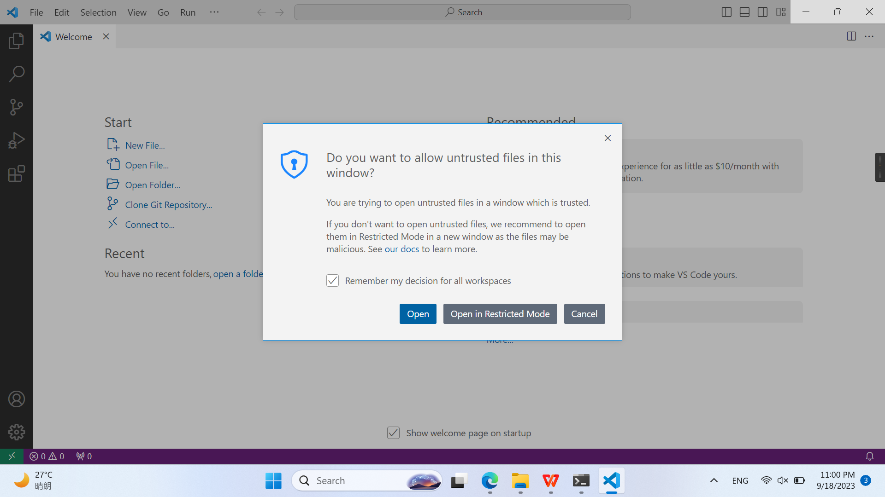

Slide 54
Python Extension
Note: As you start to use VS Code, these messages for extension installtion will appear automatically time to time to support the working environment.

Slide 55
Install Python + Jupyter Extension

Slide 56
Install Python Environment

Slide 57
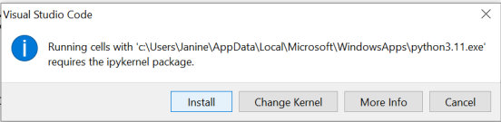
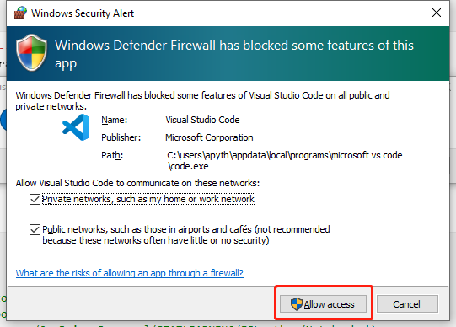
Install Ipykernel
If this message occurs, install ipykernel:

Slide 58
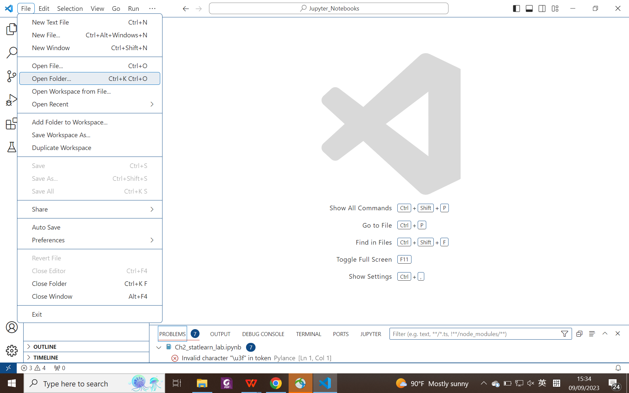
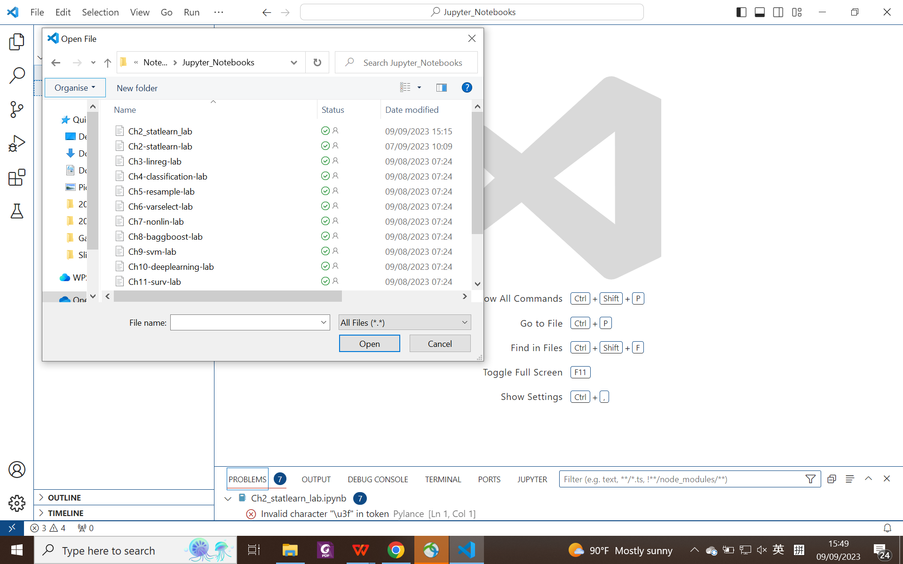
Open Folder
Open the folder of your course Notebooks and open the first jupyter notebook file of the course

Slide 59
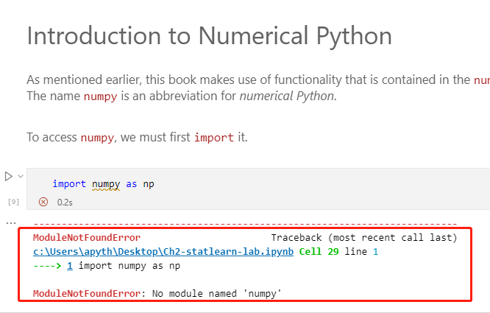
Install “numpy” using VS Terminal

Slide 60
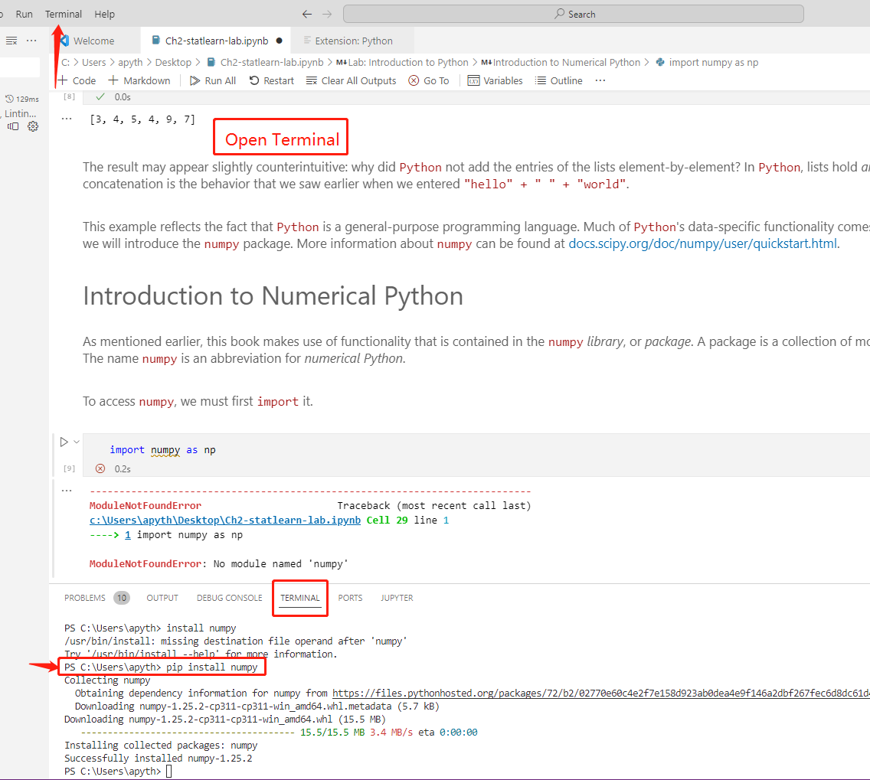
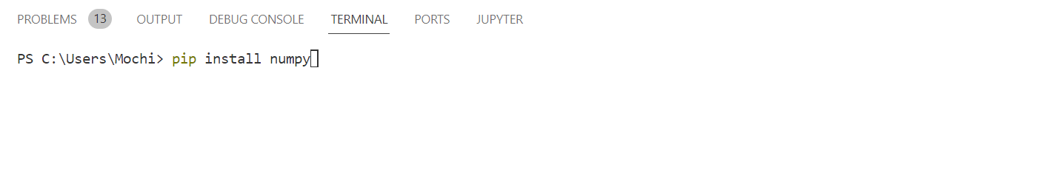
Install “numpy” using VS Code terminal
pip install numpy

Slide 61
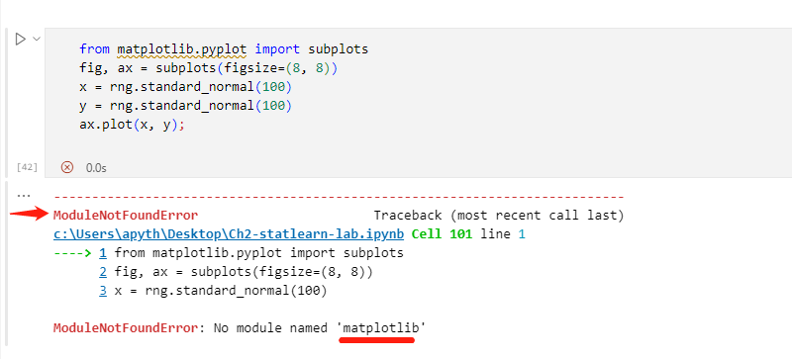

Note: In case of error, it might ask you to install a package in the upcoming chapters… You may repeat the same procedure to install a package
pip install matplotlib

Slide 62

Install Package
Due to the offline nature, we need to install some packages required for the course. Taking NumPy as an example:

Slide 63

Install Package
Move the cursor to the "terminal" in the menu bar, and then click on "new terminal".

Slide 64

Installation Tips
Ensure that the Python environment you are using in VS Code matches the Python environment where NumPy is installed.

Slide 65

Installation Tips
If not, click “select kernel” again, and choose the correct Python.

Slide 66


